Slide 1
WUXI SKY EYE OCR
09/07/2020
Brad Qiu

Slide 2
VCSEL TRACING
SN
MES
WAFER LEVEL
Previous VCSEL Trace
Current VCSEL Trace With OCR
SN
OCR (wafer,X,Y)
VCSEL LEVEL

Slide 3
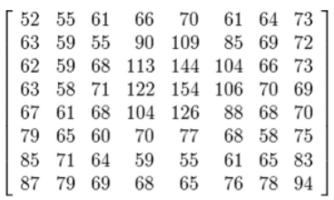

OCR THEORY
IMAGE-LABEL KNOWLEDGE LIBRARY
KNN,SVM, ANN_MLP
Machine Learning
AI
OUTPUT
3

Slide 4
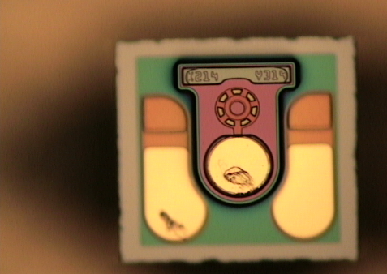
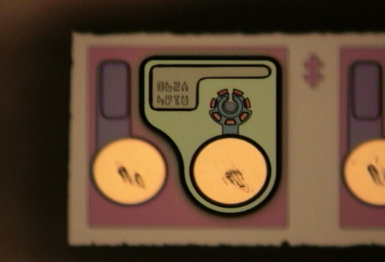
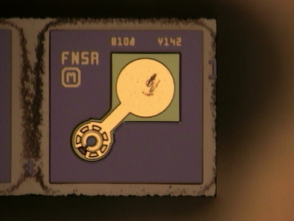
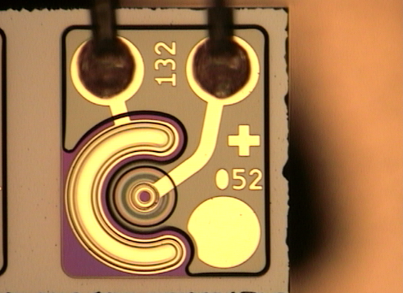
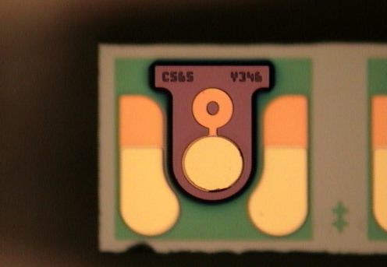
VCSEL TYPE

Slide 5

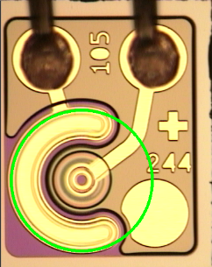
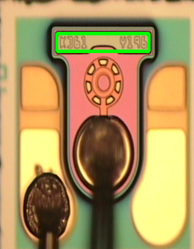

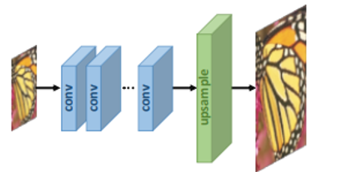
IMAGE PROCESS
VCSEL IMAGE
DETECT IMAGE TYPE
CAPTURE COORD
IMAGE ENHANCE
SPLIT CHAR IMAGE

Slide 6
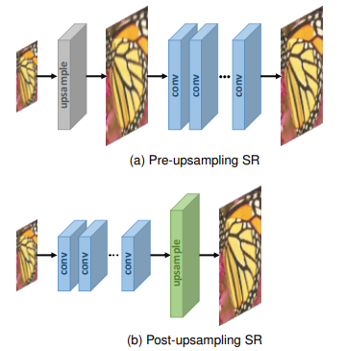
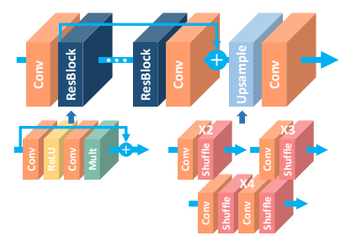
CNN(Convolutional Neural Network) IMAGE ENHANCE

Slide 7
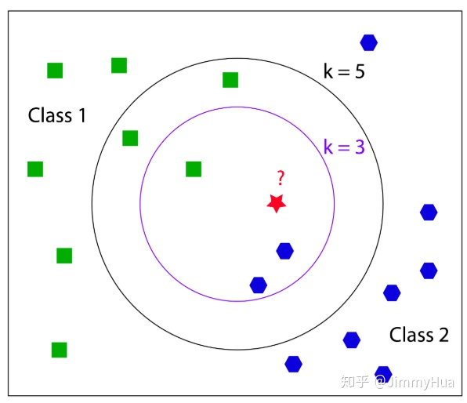
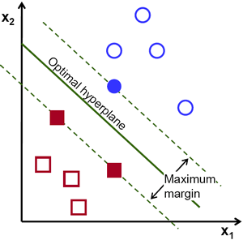
AI MACHINE LEARN – KNN/SVM

Slide 8
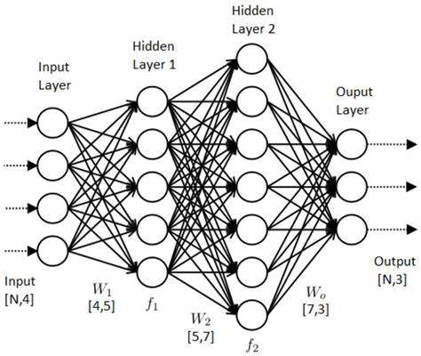
AI MACHINE LEARN – ANN_MLP

Slide 9
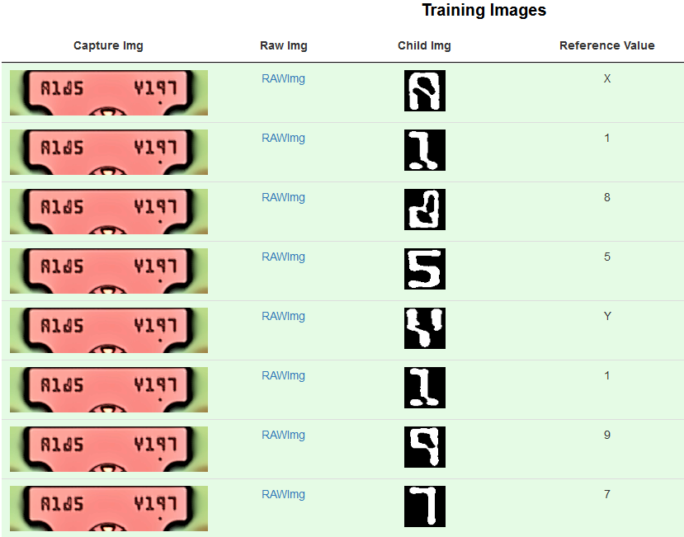
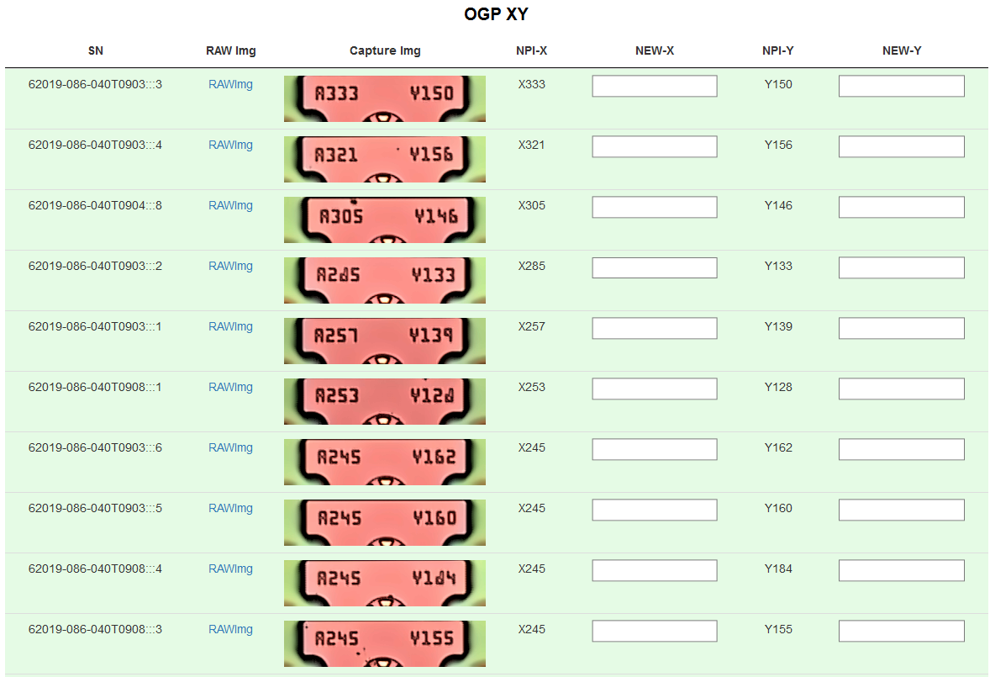
SKY EYE OCR

Slide 10
SKY EYE ADVANTAGE
Comparing | Commercial OCR | SKY EYE OCR
COST | $10K+ / LICENSE | $0
CORRECTIVE RATE | 85% | 97+%
HUMAN REVIEW | 75 mins /160 pics | 3 mins / 160 pics

